Slide 1
Food Demand Forecasting
T.KARAN(19BCE1751)
G.PRAVEEN(19BCE1029)
Y.HEMANTH(19BCE1047)
S.V.S.N.PAVAN(19BCE1090)

Slide 2
ABSTRACT
The vital aspect in the world of business is to have a proper analysis of their business outcomes. This outcome plays a major role in the development of the business. One of the expanding business spheres is food delivering companies.
The vital factor in running such a food delivery company that is located data various branch in the city is to maintain the stock properly and prepare the food in time for delivering to the customers.
The datasets used to train the model have the information regarding the meal for example, the type of meal, Week, center-id , base-price , category, cuisine etc. This prediction model helps to find out the popular meals and the least ordered type of meals, based on these results they can manage the purchase of stock and raw materials.
We have to deal with many perishable raw materials, if there is too much stock it would tend to the wastage, if the stock is insufficient, it would lead to out-of- stocks, it would lead to out of stock of the meals that in turn would decrease the number of orders for the company.

Slide 3
INTRODUCTION:
As in today’s competitive life even the business has become more difficult. Demand for food is increasing day by day with the increase in the population of every country. Estimation of the demand in food consumption plays a vital role in supplying or generating resources to produce the required amount of food.
To meet this challenge, we need to predict the demand in food consumption for future so that the hunger of everyone can be satisfied.
We will analyse all the year data on how the food demand has been through the out there restaurants . with that information we can readily produce the raw materials and also recuirt the staff requried

Slide 4
PROBLEM STATEMENT:
Food demand forecasting is about to help meal delivery companies located at various centers of the city in the demand forecasting for upcoming weeks.
The majority of the raw materials are perishable, and the replenishment of them is done on the weekly basis and the procurement planning is of utmost importance. The demand forecast is helpful in the staffing of the centres too.
The Main Motto is to predict the demand for the upcoming weeks(in the challenge the dat set containing the 10-days of meals for the customers)for the centre-meal combinations in the test set.
Here we will predict the number of orders and the demand of orders based on all the attributes given in the train data set.

Slide 5
REQUIREMENTS:
The main requirements are the train data set, test data set and the sample submission which we can download from the Kaggle.
We use train and test data sets to tarin the models and test them with our predictions. Sample submission data set is used to check weather our predicted file is in the same format as the sample submission file. We have implemented this predictive model using Python programming using Jupyter Notebook.

Slide 6
DАTА SЕT DESCRIPTION:
There are a total of 3 train data sets which are used in the processing. The three data sets are the train data set, fulfilmentcentre info data set and the meal info data set.
Train.csv data set includes all the attributes, the id’s of the fulfilment centers and meals, and also the num_orders which is needed to be predicted, this is used to train the models, the fulfilment_center_info.csv file provides us with the details of the food centres which are providing the food.
We have mergedthetrain , fulfilment center and the meal info datasets to form one train dataset and used that to build the model.

Slide 7
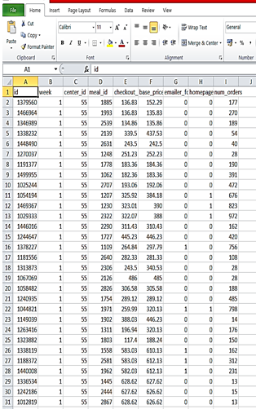
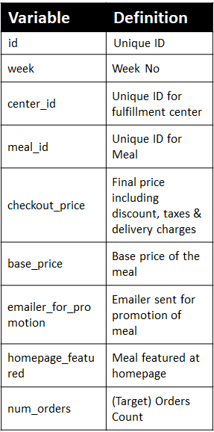
TRAIN DATASET:

Slide 8
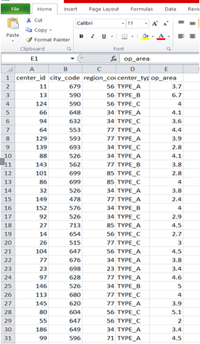
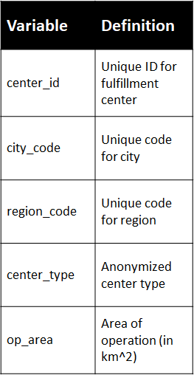
FULL FILLMENT DATASET:

Slide 9
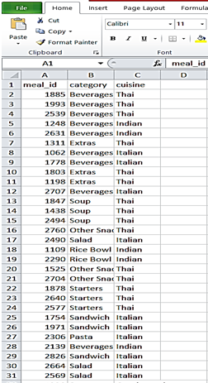
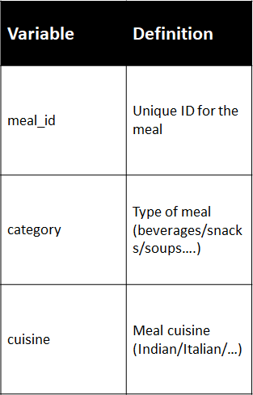
MEAL INFO DATASET:

Slide 10
MODULES DESCRIPTION:
Linera regression
XG-boost
Light-boost algorithm
Cat-boost algorithm
Random-forest algorithm

Slide 11
LINERAR REGRESSION:
In our project, we will develop the 3 models using Linear Regression. We will import the Linear Regression from sklearn_linear_model package, split the dataset into train and test and perform linear regression directly on the dataset.
In the Second Model we will perform the Standard Scaling and log transformation on the target variable.
For the Third model we will create some attributes namely quarter and year, clear the outliers using quantile method.

Slide 12
XG-BOOST
XG-Boost is a high-speed and high-performance implementation of gradient boosted decision trees. The algorithm's implementation is designed to maximize computation time and memory resources. One of the design goals is to make the most of the resources available to train the model.
The two reasons to use XG-Boost are Execution speed and Model performance. XG-Boost dominates structured or tabular datasets on classification and regression predictive modeling problems. In general, XG Boost is quick.

Slide 13
CAT-BOOST ALGORITHM:
Cat Boost algorithm can be used to solve a wide range of problems and can deal with many types of data with unique parameters which gives us accurate results. Categorical data in particularly yields better accuracy when cat boost algorithm is applied. With many parameters to tune with we can easily arrive at the best result out of all. Cat Boost algorithm also uses the gradient boosting algorithm which can yield very good result even with very small data.
This algorithm can be used without any pre-processing which is required in other algorithms. The other qualities include robustness, more accuracy and easy to implement. Most of the datasets can be processed by the default settings of the parameters without tuning them.

Slide 14
RANDOM FOREST ALGORITHM:
Random Forest Algorithm : It is a algorithm with decision tree Model, in which the sub trees are learned.
Resulting predictions from all the sub-trees will have less correlation. Here it tries to build multiple CART models with different samples and initial variables. It will repeat the same process and then can make a final prediction.
This final prediction can simply be mean of each prediction. For example, if we have1000 observations in the complete population with 10 variables. It will take a random sample of 200 observations and 5 randomly chosen initial variables to build CART model. It will repeat the process say 10 to 12 times and then make a final prediction on each observation.

Slide 15
REFRENCES:
Demand forecasting for production planning in a food company by nathaila barbosa
https://www.researchgate.net/profile/Nathalia-Barbosa 2/publication/285219852_Demand_forecasting_for_production_planning_in_a_food_company/links/59b930fca6fdcc687230e27b/Demand-forecasting-for-production-planning-in-a-food-company.pdf
Demand forecasting for the ration companies by Langdon (Landon) Hollingsworth
https://dspace.mit.edu/bitstream/handle/1721.1/131054/Hollingsworth_Xiang_project_Demand%20Planning%20for%20United%20Nations%20Food%20Rations_REVISED.pdf?sequence=1&isAllowed=y
An Exploration of and Case Studies in Demand Forecast Accuracy: Replenishment, Point of Sale, and Bounding Conditions by Kevin Barry Smyth, M.S. Graduate Program in Business Administration
https://etd.ohiolink.edu/apexprod/rws_etd/send_file/send?accession=osu1506682418566979&disposition=inline

Slide 16
THANK YOU
-DR.MAHESWARI MAM

